Slide 1

Food Delivery Time Prediction
By Subham varma

Slide 2

Why food delivery time prediction topic?
Keeping transparency with the customers became important
Providing better accuracy in services and information increase public satisfaction
Keeping records & providing most possible accurate time is conventionally impossible
For doing so, we have to take the help of Machine Learning models which are-
Fast and most accurate
Compatible with websites & applications

Slide 3

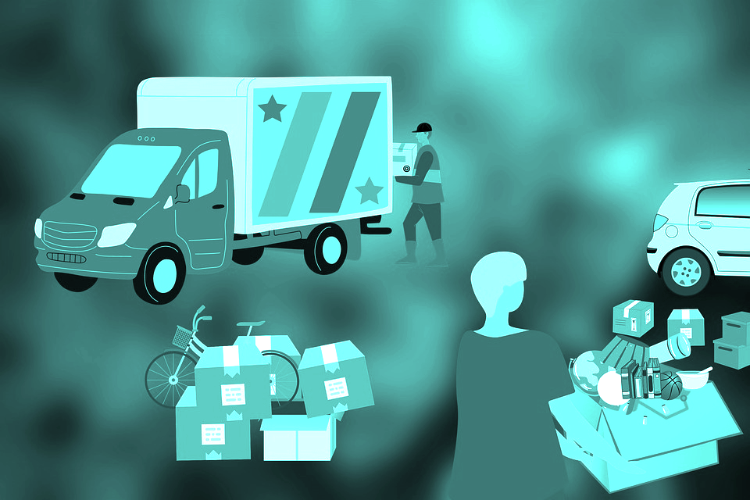
Problem Statement & Aim
The goal of this project to predict the food delivery time in real-time using various Machine Learning techniques
For the benefit of the customers as well as the service providers, a well analyzed time prediction model will be served
The hectic for providing so many features to get the real-time will be reduced by estimating the most mattering features
There are many applications which are predicting the time and are doing well, our goal here is to provide better result to those applications by selecting a better model and training it

Slide 4

How will we approach the Problem?
Tools we used:
Python Programming Language
Python Libraries-
Pandas
Numpy
Matplotlib
Seaborn
Scikit Learn
Jupyter Notebook IDE
Steps we followed:
Data Gathering
Exploratory data analysis(EDA)
Data wrangling
Data visualization
Data Pre-processing
Splitting data
Selecting & training model
Testing model

Slide 5
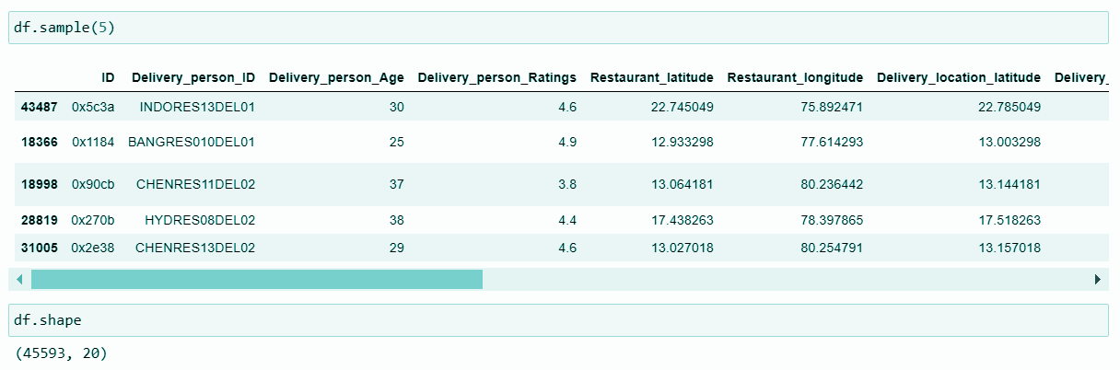
About Dataset
The dataset is available here in Kaggle:
“https://www.kaggle.com/datasets/gauravmalik26/food-delivery-dataset?resource=download&select=train.csv”

Slide 6

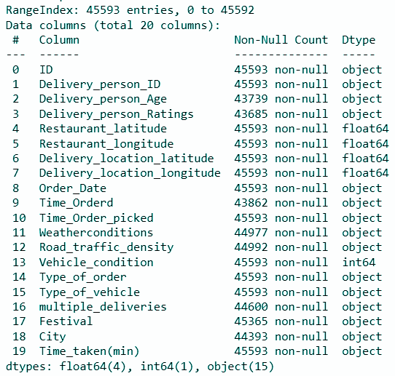
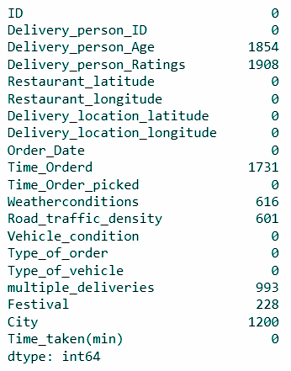
Column Names | Column Data-types | Total null values in Columns

Slide 7

Data Cleaning Operations
The problems identified in the data set -
Many unwanted columns in context of Time prediction like -
['ID', 'Delivery_person_ID', 'Order_Date', 'Time_Orderd', 'Time_Order_picked', 'Festival', 'Vehicle_condition',
'Type_of_vehicle', 'City']
Dropped unwanted columns
2) Many null values in some columns
For numerical cols = Imputed null values with Median values
For categorical cols = Imputed null values with most recurring category
3) Problem with the format of values in few columns
Corrected the format by using split operation
4) Inappropriate Datatype of columns
Changed the Datatype as suitable for columns

Slide 8
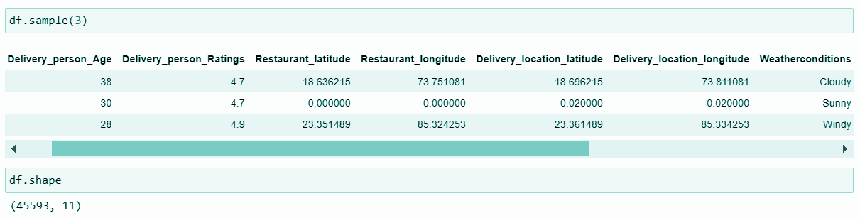
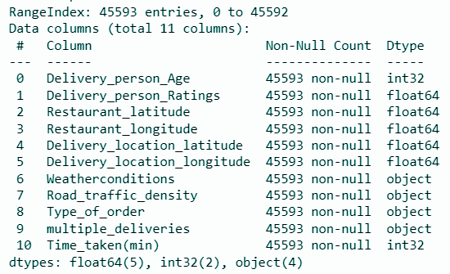
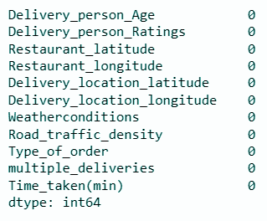
Data After Cleaning

Slide 9

Feature Engineering
Distance(km) is the very important feature that we need to predict our target variable i.e. time_taken
Hence we are going to create a new column named "Distance(km)" with the help of existing features i.e. lat & lon of Restaurant & Customer
For computing distance, we are going to use Haversine Formula (The haversine formula is a very accurate way of computing distances between two points on the surface of a sphere using the latitude and longitude of the two points.)
After creating this new feature, we will add this to our dataframe and drop the used features as we have already extracted the pattern out of those in the new feature
At this point, there are 4 Numerical and 4 categorical columns

Slide 10
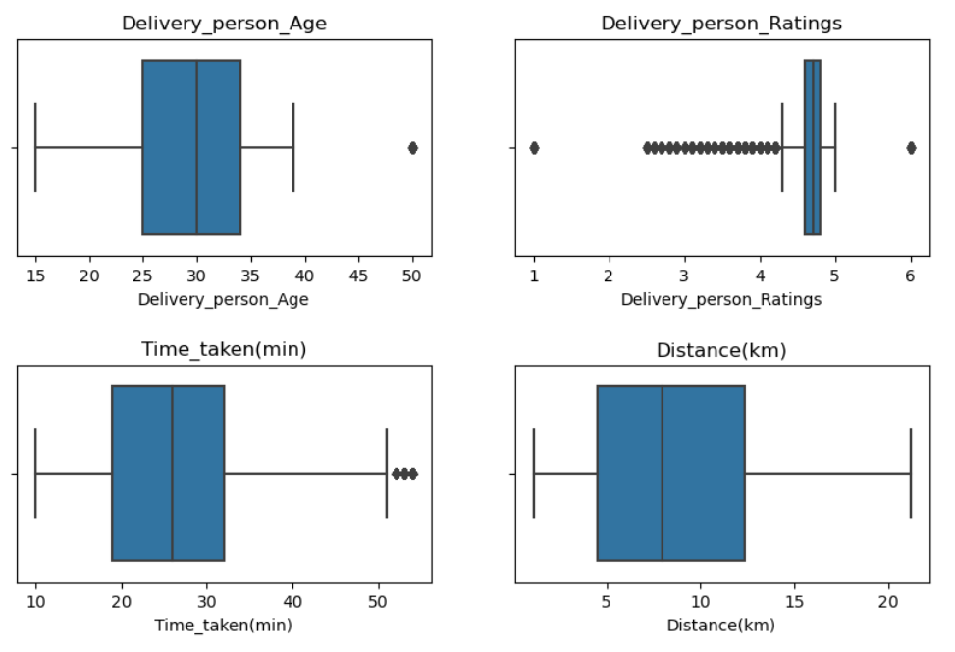
Data Visualization (Univariate Analysis)
For Numerical features, we will go with the Boxplot to get the distribution of data in each feature
Outliers Detected in features:
Delivery_person_Age
Delivery_person_Ratings
Time_taken(min)
We will drop these outliers

Slide 11
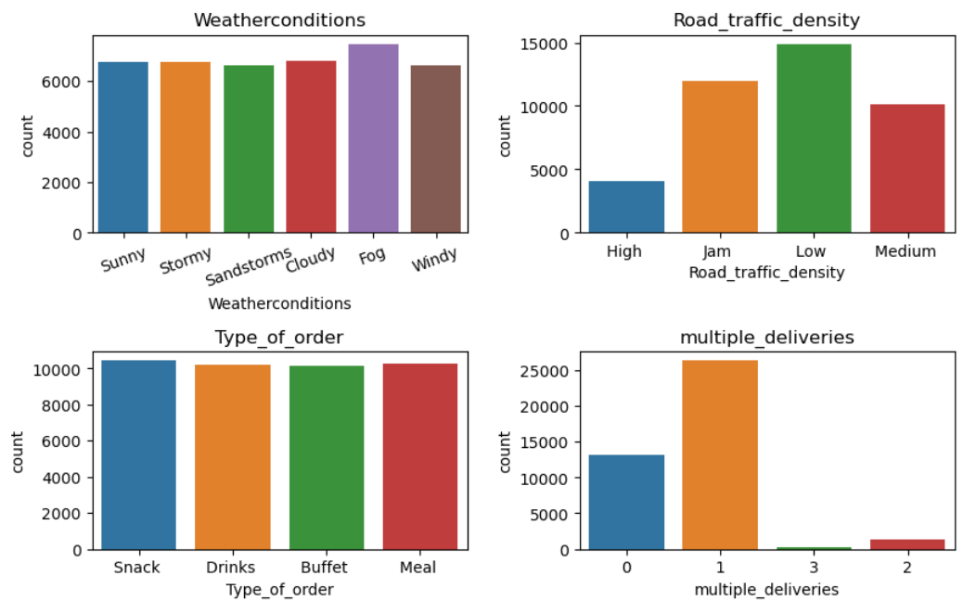
Data Visualization (Univariate Analysis)
For Categorical features, will go with the Countplot to get the distribution of data in each feature
Imbalance data Detected in features:
Road_traffic_density
Multiple_deliveries
We will use Stratified sampling method while splitting the data for modeling to handle this

Slide 12
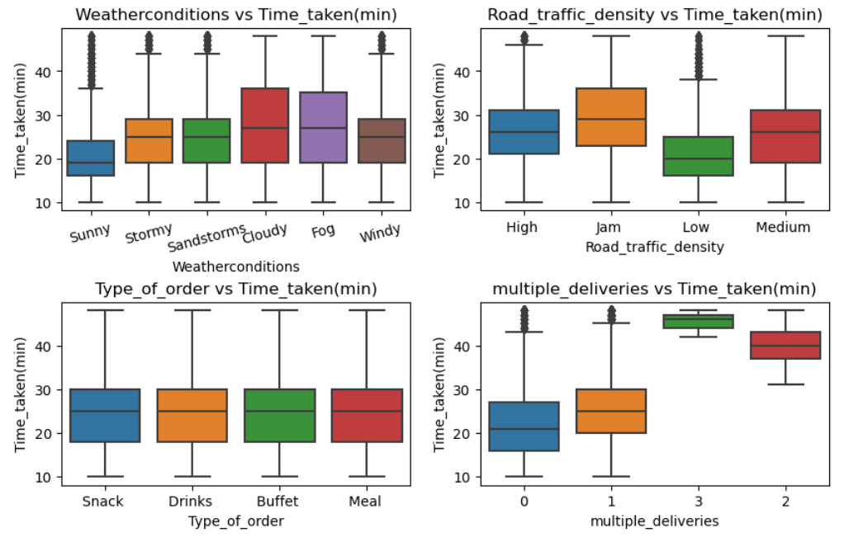
Data Visualization (Bivariate Analysis)
Here we can see how the Categorical features are influencing our Target variable with the help of Boxplot
Observation:
All categorical features are influencing the ‘Time_taken’ variable except for the ‘Type_of_order’ which isn’t showing any variations

Slide 13
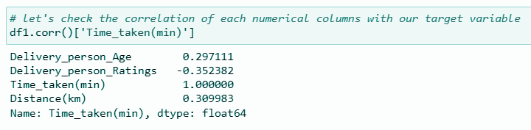

Target variable Correlation with other numeric columns
From above it's very clear that:
‘Time_taken’ is positively correlated to ‘Delivery_person_Age’ and ‘Distance’
‘Time_taken’ is negatively correlated to ‘Delivery_person_Ratings’

Slide 14

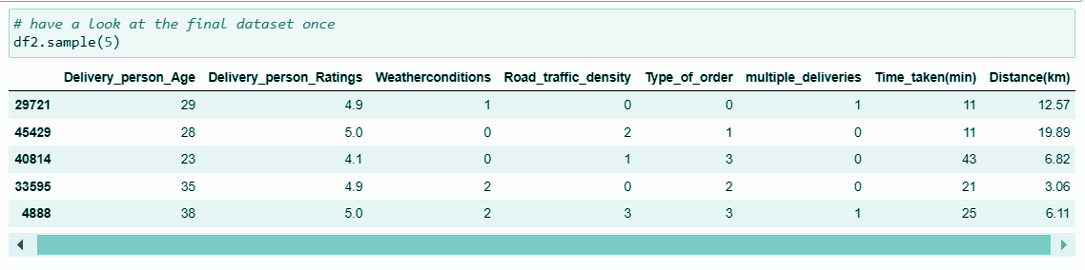
Pre-processing data:
Before using the data for ML algorithms, firstly we have to convert categorical variable to numerical by doing Encoding operation
We used mapping method to encode categorical variables
Below image shows how data looks after pre-processing

Slide 15

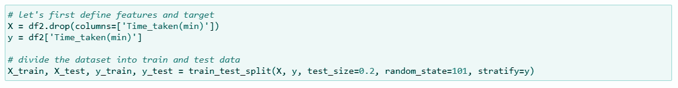
Splitting the data (to train, test, X_label, y_label):
We will go for data splitting by using train_test_split() function from Scikit Learn library and split the data as X_train, X_test, y_train, y_test
Here ‘X’ defines the Independent features and ‘y’ defines Target variable
While providing the parameters for train_test_split() function, we will enable the stratified sampling as we decided before

Slide 16
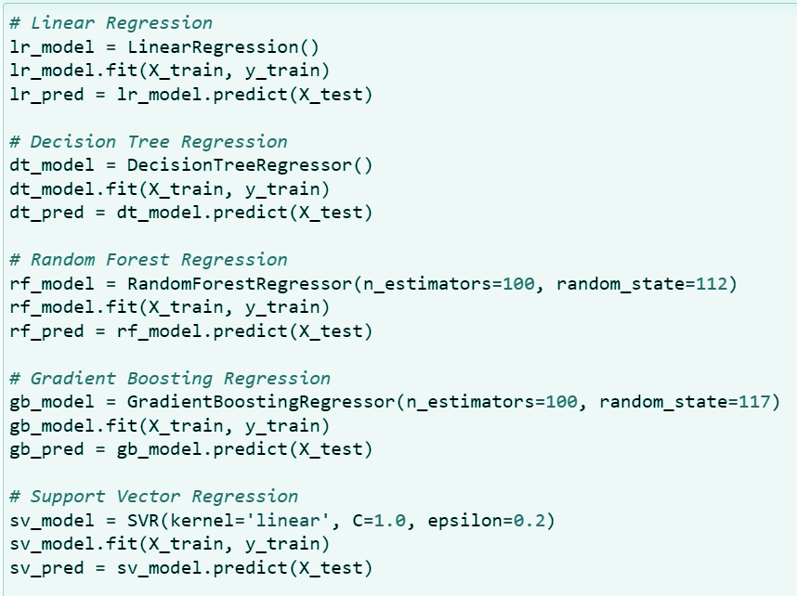
Selecting & training ML model:
The 5 most suitable Algorithms for our dataset will be:
LinearRegression
DecisionTreeRegressor
RandomForestRegressor
GradientBoostingRegressor
SVR
After training this models with our train dataset we used evaluation metrics to validate our models and to select one by comparing their r^2_score and mean_square_error

Slide 17
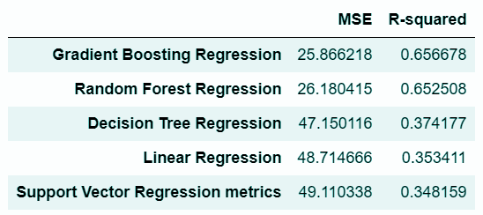
Model selection:
The Results after training our models in terms of evaluation metrics are shown here in sorted order
Top 2 contenders for model would be GradientBoostingRegressor or RandomForestRegressor
Here I am going with the GradientBoostingRegressor model as it has the highest score

Slide 18

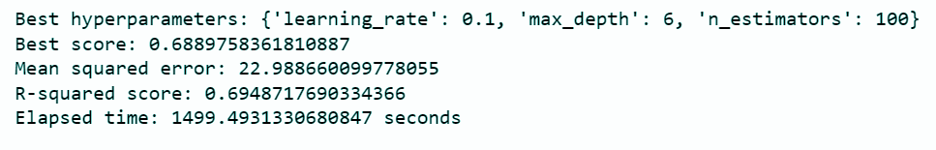
Tuning the selected model:
To get the best hyper parameters for our ensemble model we can use GridSearchCV() function from sklearn.model_selection
This function outputs the best hyperparameters out of list of parameters that we provide for our model
Then we train our model with this hyper-parameters and present the final model which can predict the best possible time for the input.

Slide 19

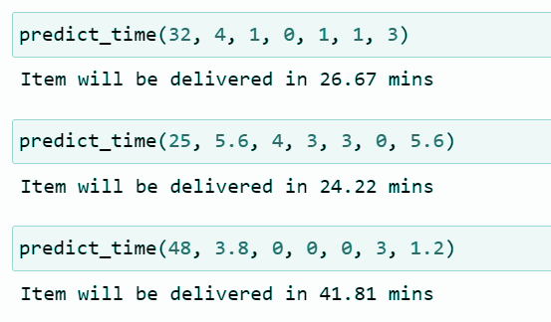
Conclusion:
Our Food Delivery Time Prediction Model is ready predict values with the necessary inputs
Below are some of the test samples
A input can be easily given with the help of prompt-
{'Delivery_person_Age', 'Delivery_person_Ratings', 'Weatherconditions', 'Road_traffic_density', 'Type_of_order', 'multiple_deliveries', 'Distance'}

Slide 20


